Slide 1
DOORDASH
SQL Project
Presented By -
Amelia Mazer, Kirtana Kirtivasan, Pratik Deshmukh
and Swetha Vijaya Raju

Slide 2
CONTENTS
1. Business Scenario
2. Flow Chart + Swim Lane Diagram
3. Entity Relationship Diagram
4. Creating Tables in SQL
5. Inserting Data in Tables
6. SQL queries
7. Visualizations
8. Conclusion & Learning

Slide 3
1
Business Scenario
Adam is super hungry after a long day at grad school, finishing his DBMS
group assignment. He is too tired to cook for himself and wishes he could
get his food ready with a swish of his wand. Its already 10:45PM Unfortunately, he never
received his admit letter from Hogwarts. He sighed and turned on YouTube
to check for quick recipes online. He typed 'easy sandwich recipe' and got
Gordon Ramsay's video. He got annoyed when Youtube started playing an
advertisement. When he was about to skip the ad, he noticed that the ad
was about a food delivery service and he got intrigued. After all, muggles
have their own ways to get things done.
Adam opens Doordash at 11PM and the app checks to see if he is an existing
customer or not. If he is not, the app moves ahead with authenticating his
username and password. If he is a new customer, the app would ask Adam
to make an account, with a username, password, address verification, etc.

Slide 4
1
Business Scenario
Once logged in, the app gives a list of different restaurant options and cuisines for
Adam. Once he selects a certain cuisine, he would see options for the possible
restaurants in his area based on his address.
On selecting the restaurant, Adam would see the menu of his restaurant of choice
with different prices on the different food options. Adam would look through the
different menu options and choose what he wants to eat for the night by adding it to
the cart. After selecting his food and beverage, he would click the checkout button
where the app would take him to the payment page. Adam would choose a payment
method, but if he is an existing customer, the payment may already be saved,
otherwise he would have to type in his card number. Doordash will confirm payment
from the selected payment method and give an alert to the restaurant to accept the
order. Once accepted, he would receive a confirmation and an estimate as to when
his order would be delivered.

Slide 5
1
Business Scenario
Doordash would assign the order to the appropriate delivery agent and update
Adam on the name of his delivery agent, what car the agent drives, and
the car license plate. When the agent picks up the food, Adam would get another
notification on the app that the delivery agent has picked up the food and is on his
way. He would know the exact estimate of time for delivery. Its about 15 minutes. During this
time, the estimated time of delivery would be updated as well.
When the food delivery agent is close by, Adam would get a notification that the
agent is close by and ask Adam to get ready to meet up with the agent. The delivery
agent drops off the food and Adam is super happy. Adam is then prompted to enter reviews and ratings for the agent and the restaurant.

Slide 6
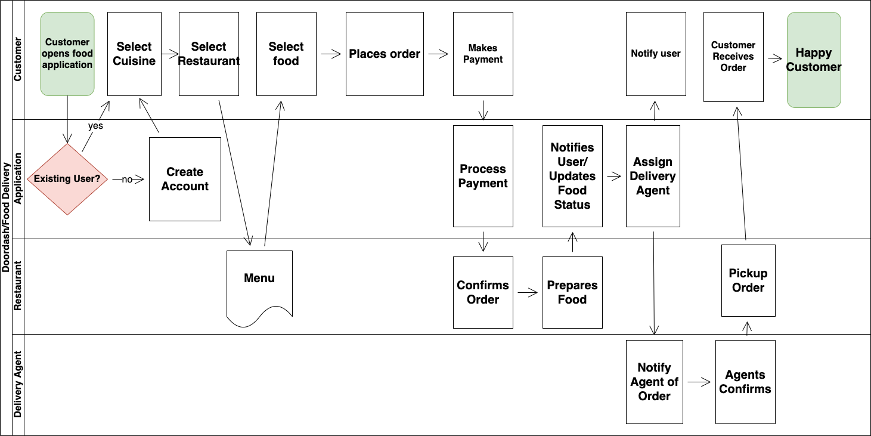
2. Flow chart (Process)

Slide 7
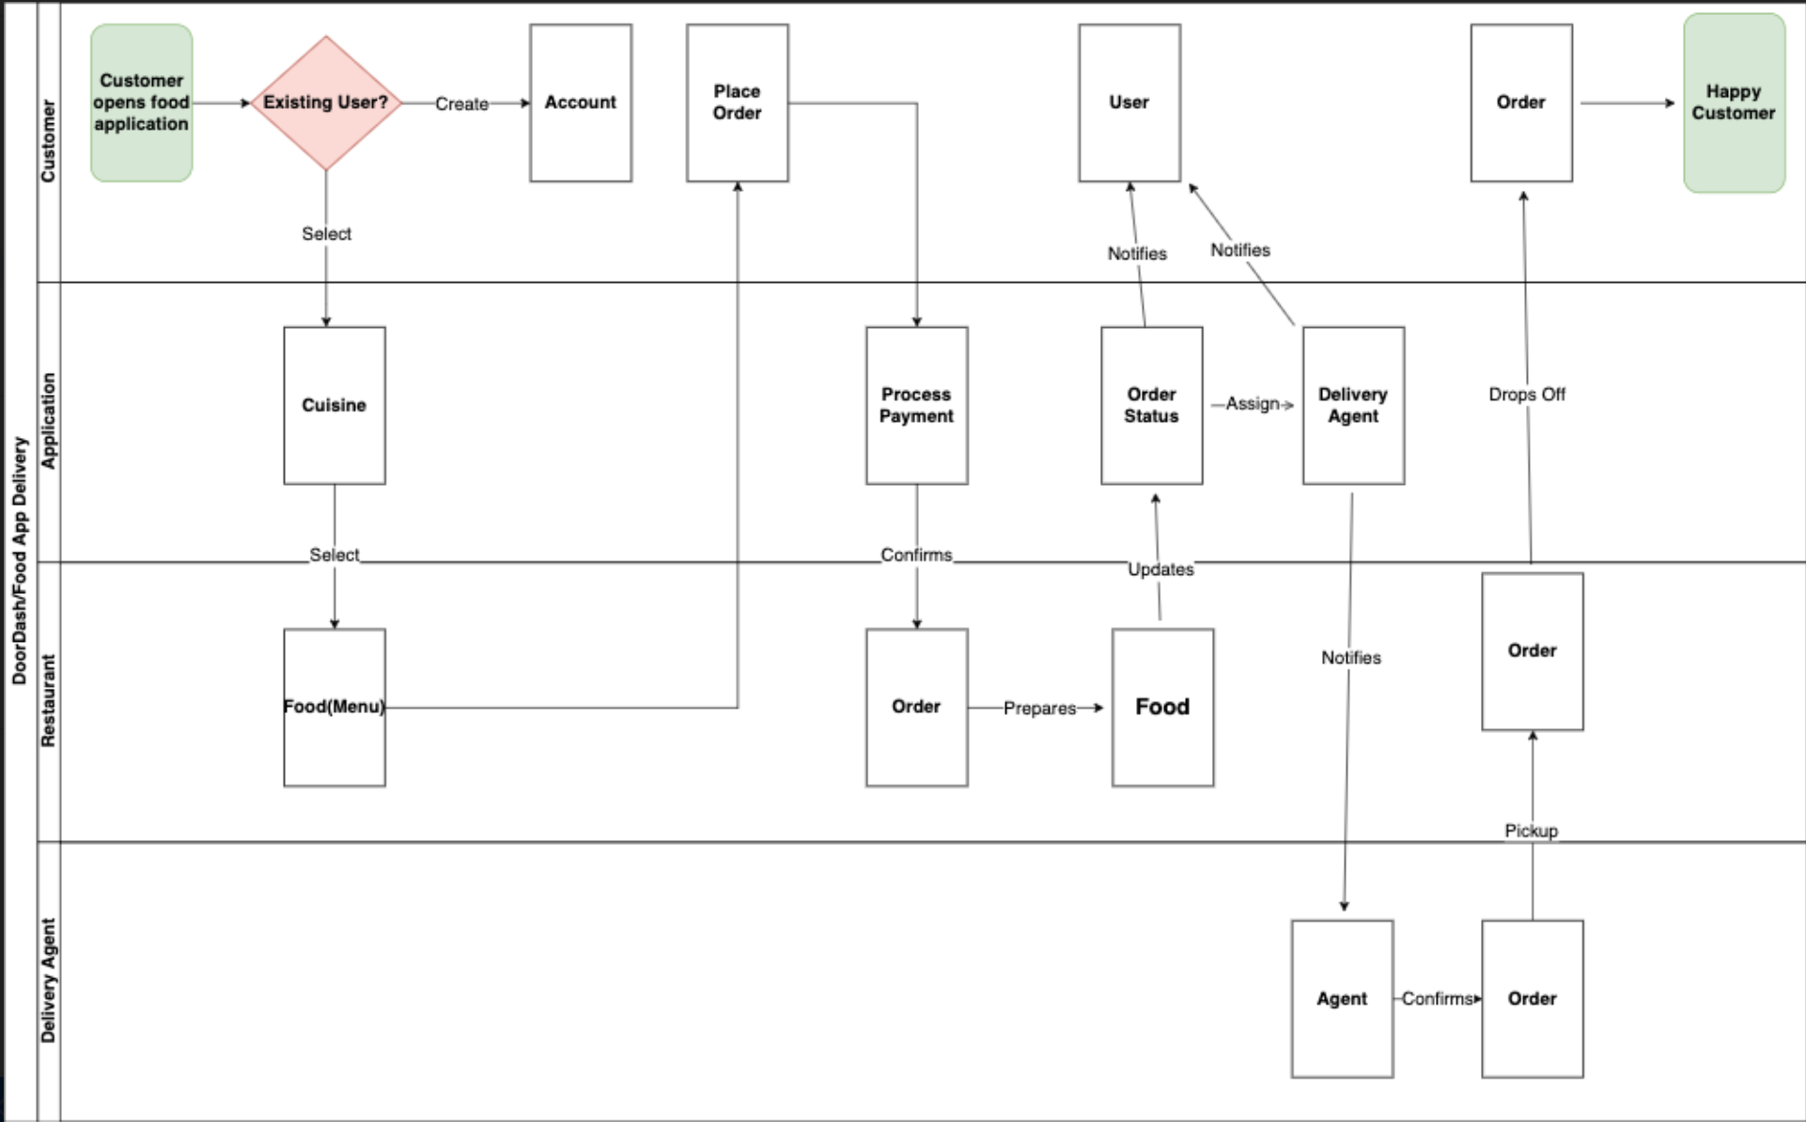
2. Swim Lane Diagram

Slide 8
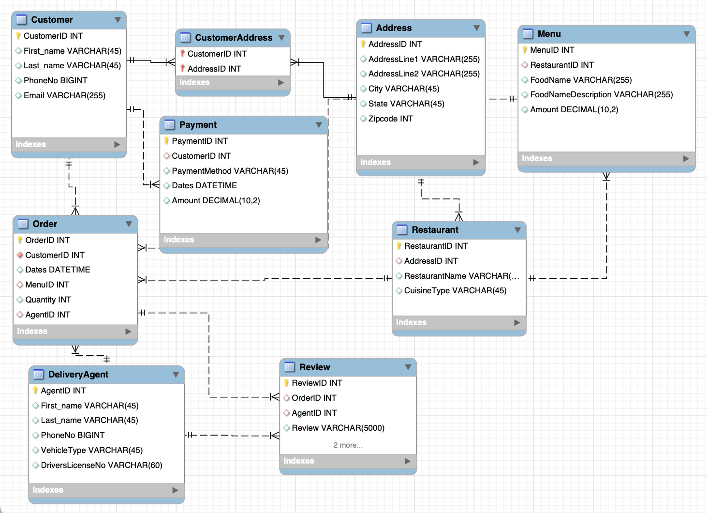
3. Entity Relationship Diagram

Slide 9
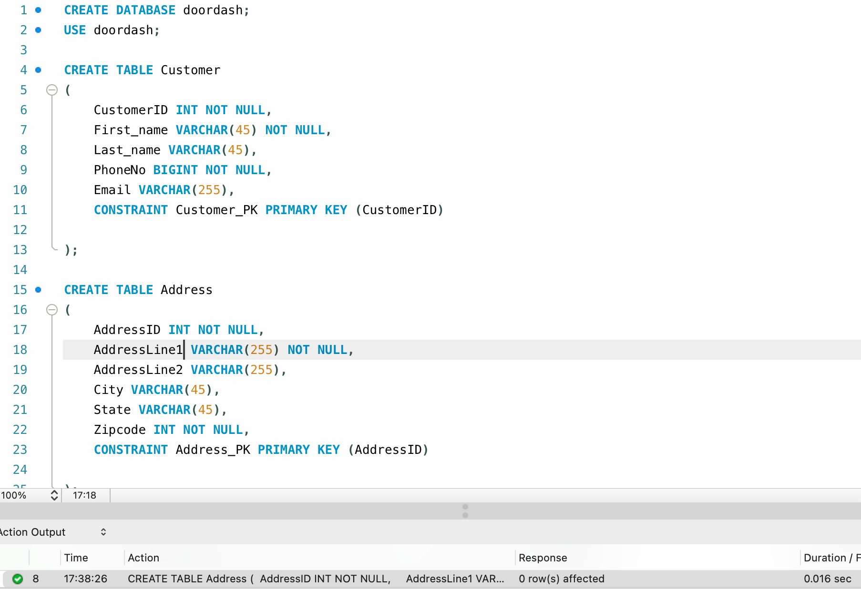
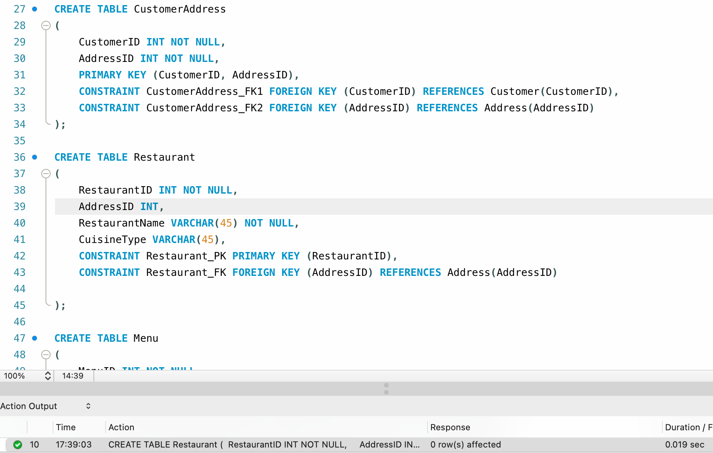
4. Creating Tables in SQL

Slide 10
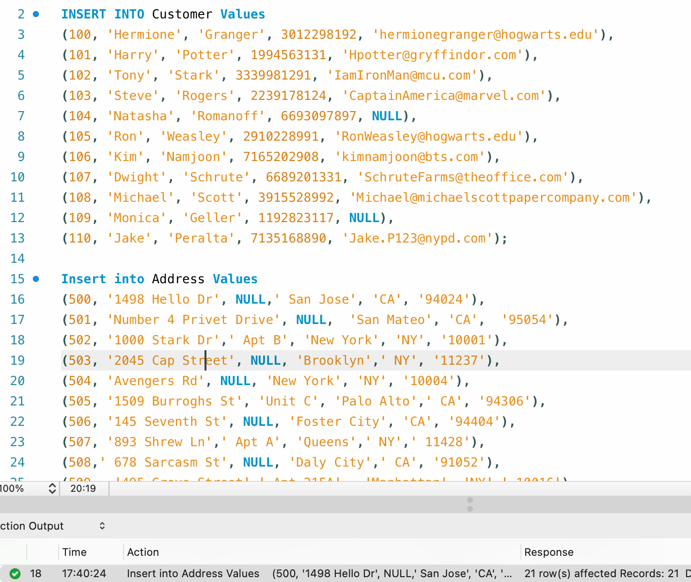
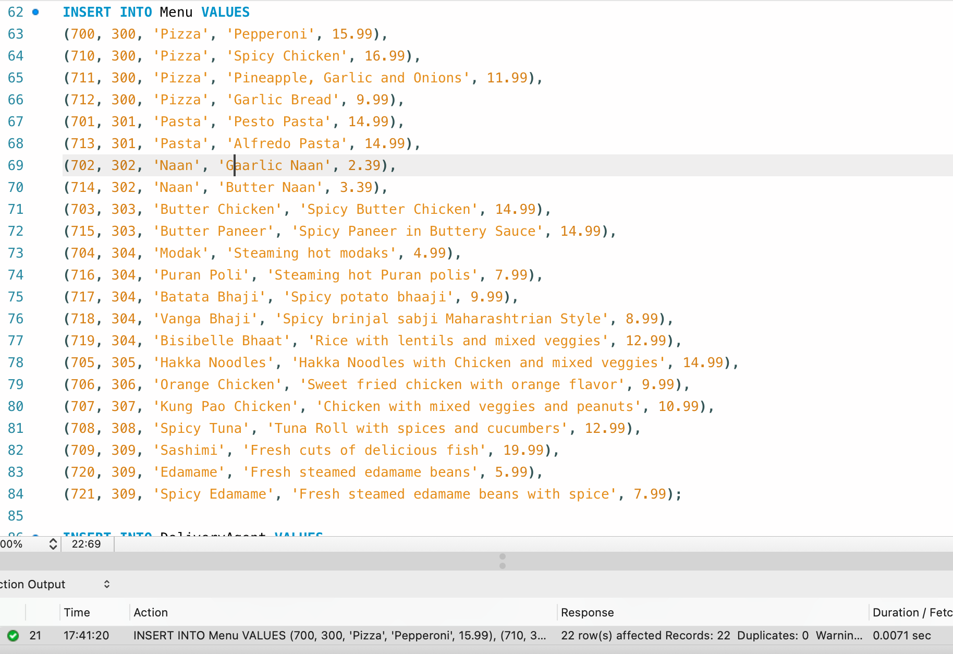
5. Inserting Data in tables

Slide 11
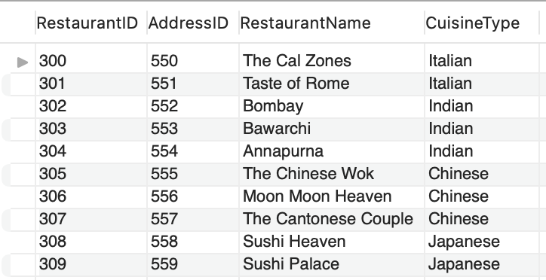
5. Inserting Data in tables
This is what our Restaurant Table looks like -

Slide 12
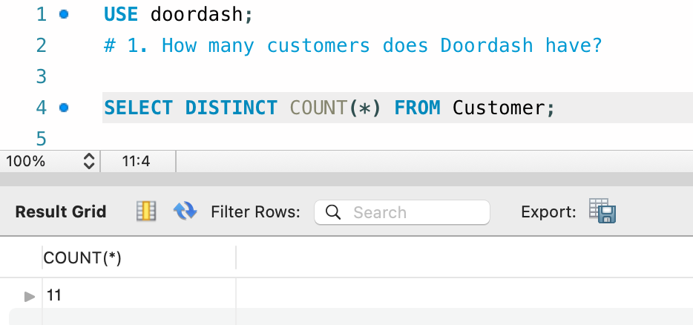
6. SQL queries

Slide 13
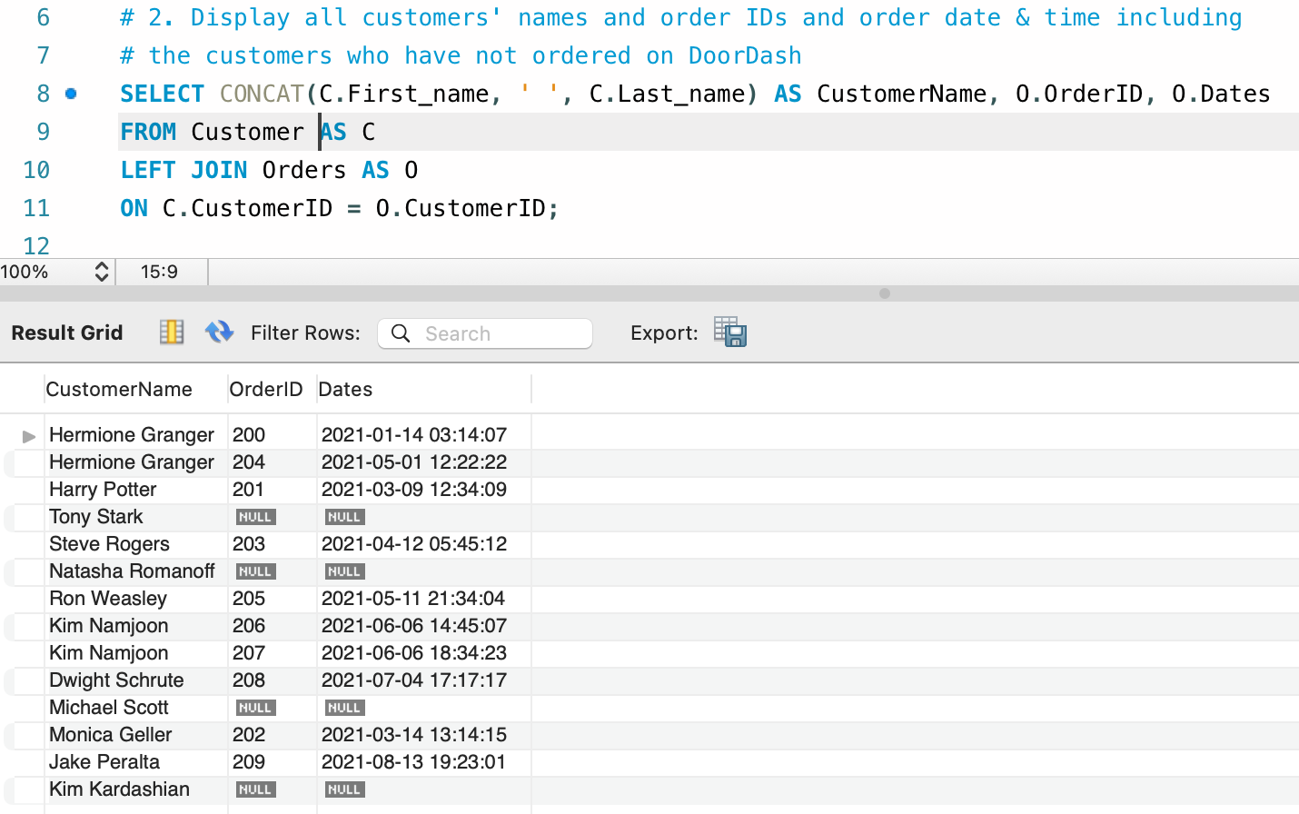
6. SQL queries

Slide 14
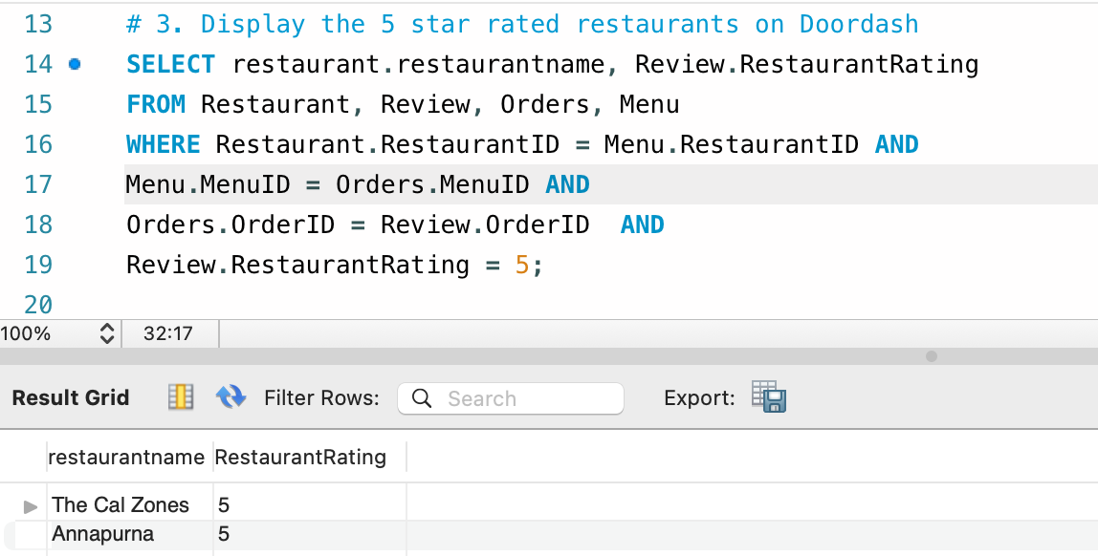
6. SQL queries

Slide 15
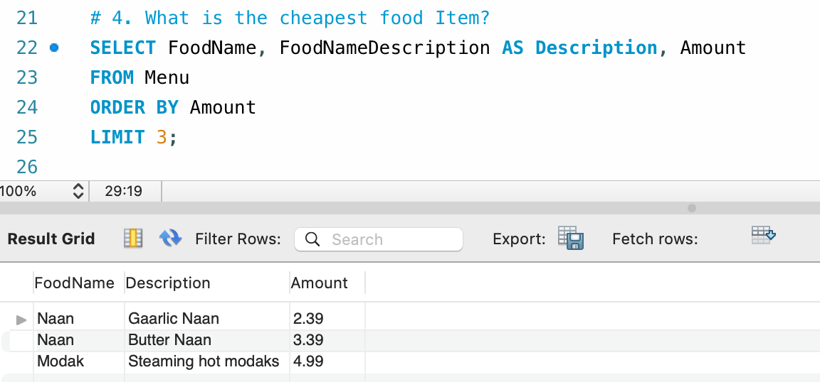
6. SQL queries

Slide 16
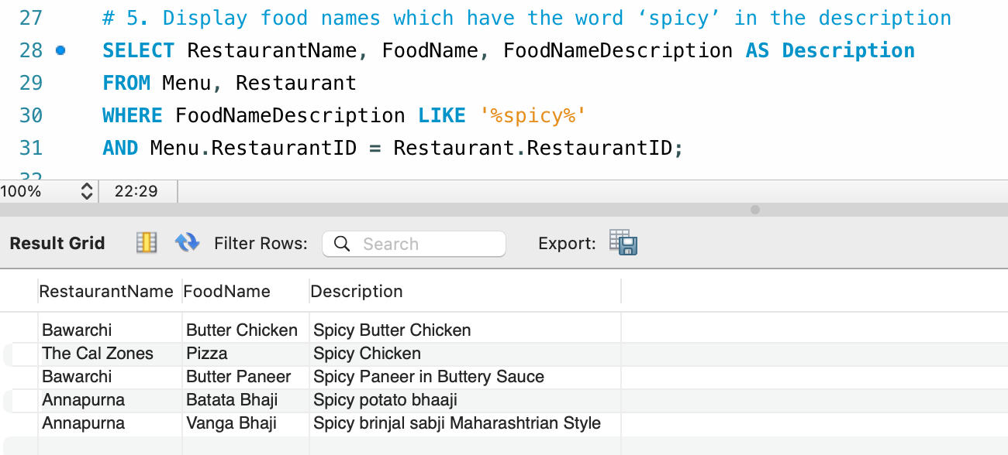
6. SQL queries

Slide 17
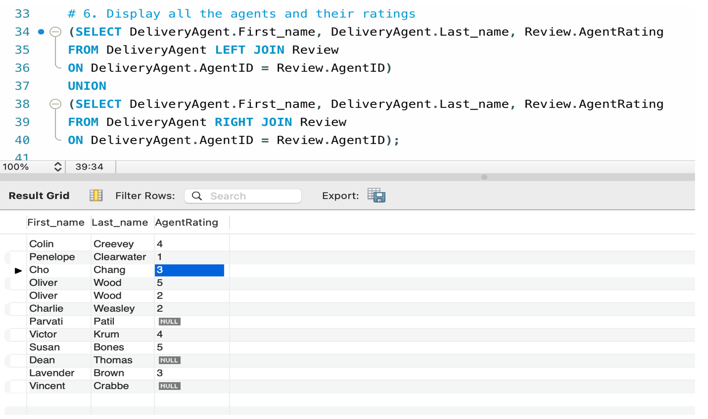
6. SQL queries

Slide 18
6. SQL queries

Slide 19
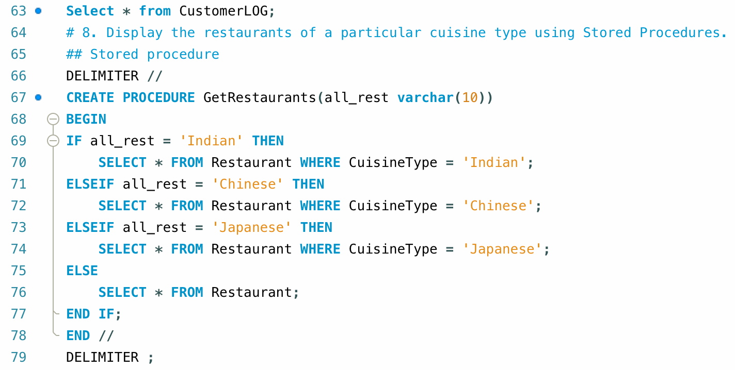
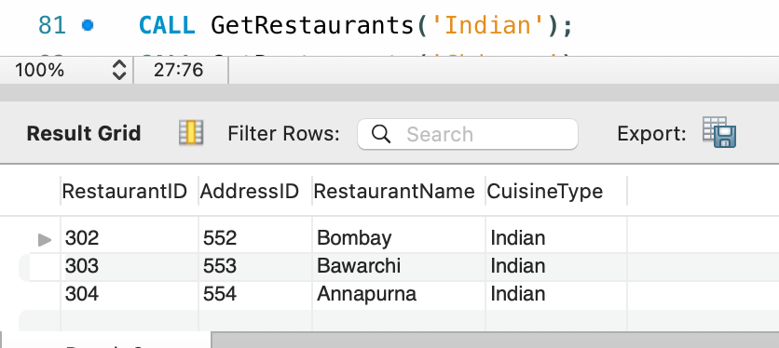
6. SQL queries

Slide 20
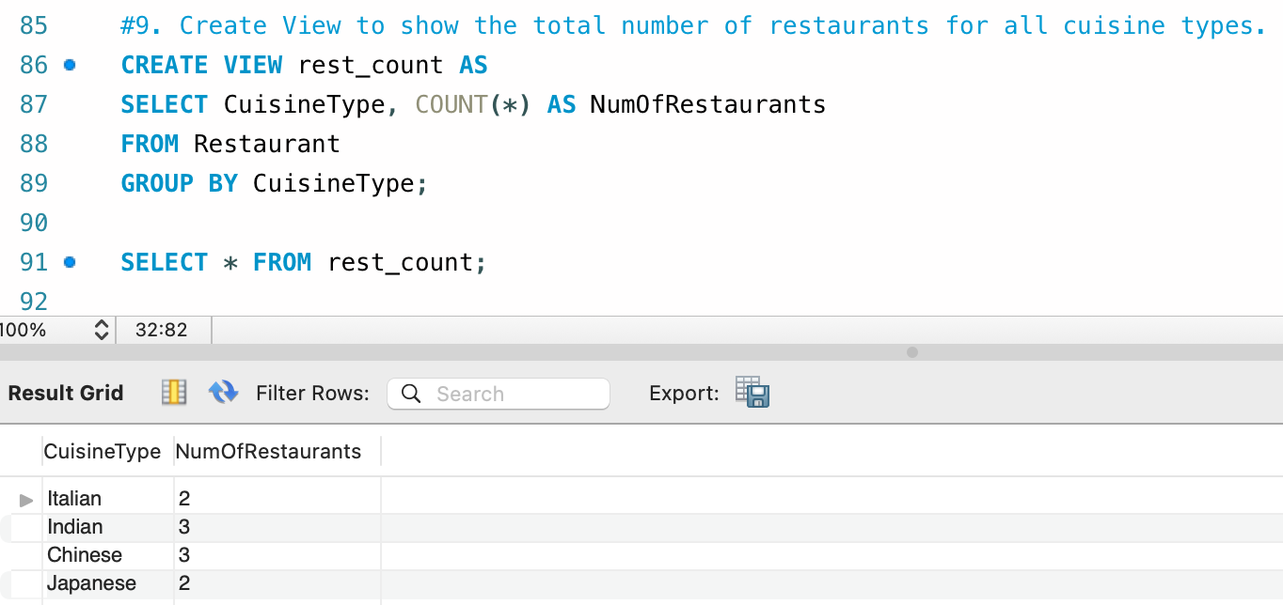
6. SQL queries

Slide 21
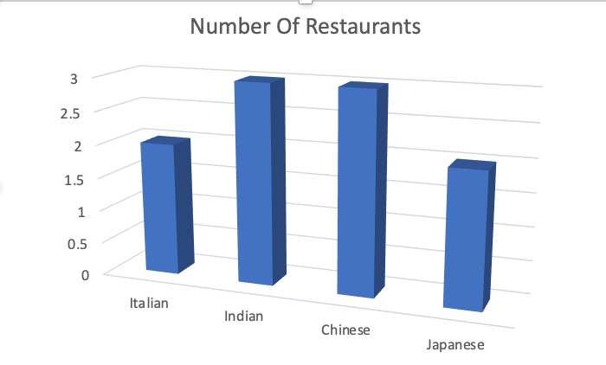
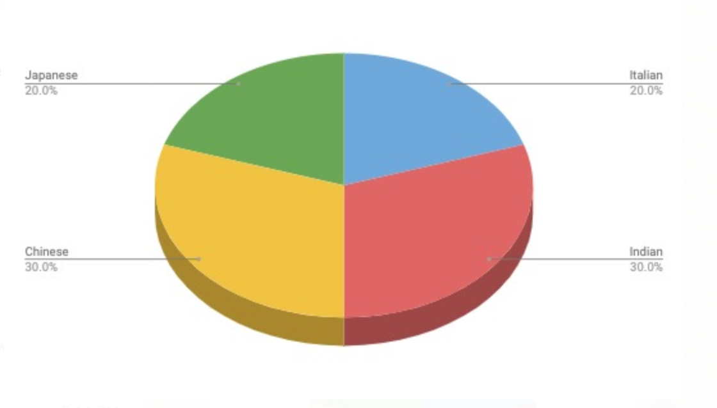
7. Visualizations
Number of Restaurants of different cuisines on Doordash

Slide 22
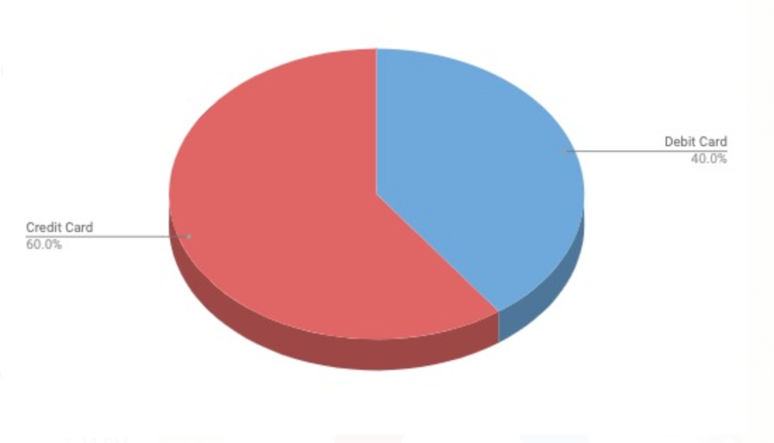
7. Visualizations
Credit card users compared with Debit Card users on file

Slide 23
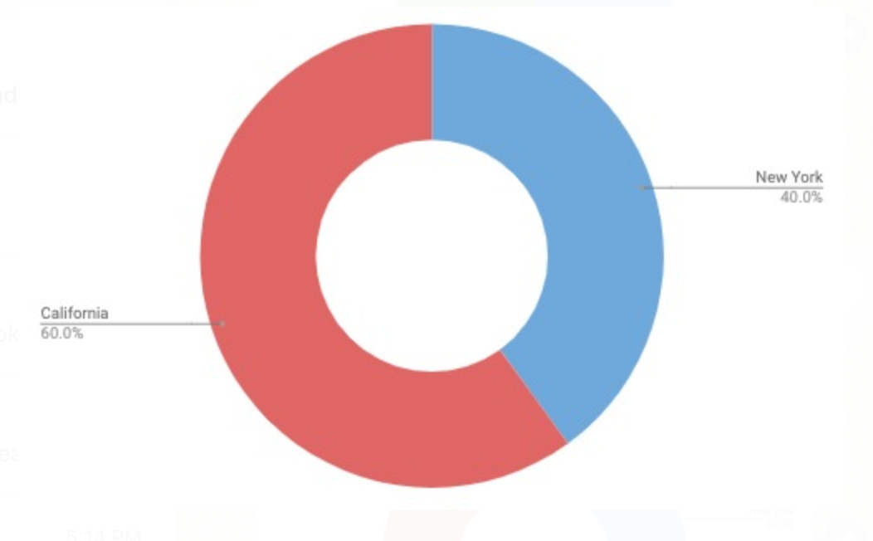
7. Visualizations
No. of restaurants by state

Slide 24
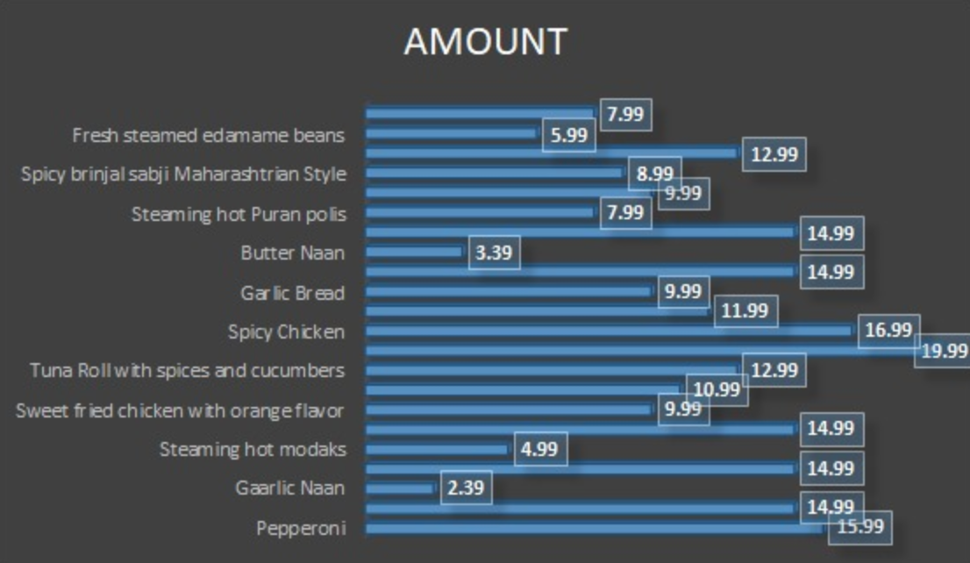
7. Visualizations
Comparative Costs of food items on the app

Slide 25
8. Conclusions & Learnings
Since the size of the database is small, the results and visualizations could be less impactful
We can use SQL to extract required information from any database and use that data to draw conclusions by using different visualization methods
A database can be constructed in several different ways
We learned that our database is simple, and a real-life working model would have several more layers of complexities
If we were to develop this model further, we could add a Menu type to the menu table, Address Type to the address table and status table for orders using triggers and create logs as well

Slide 26
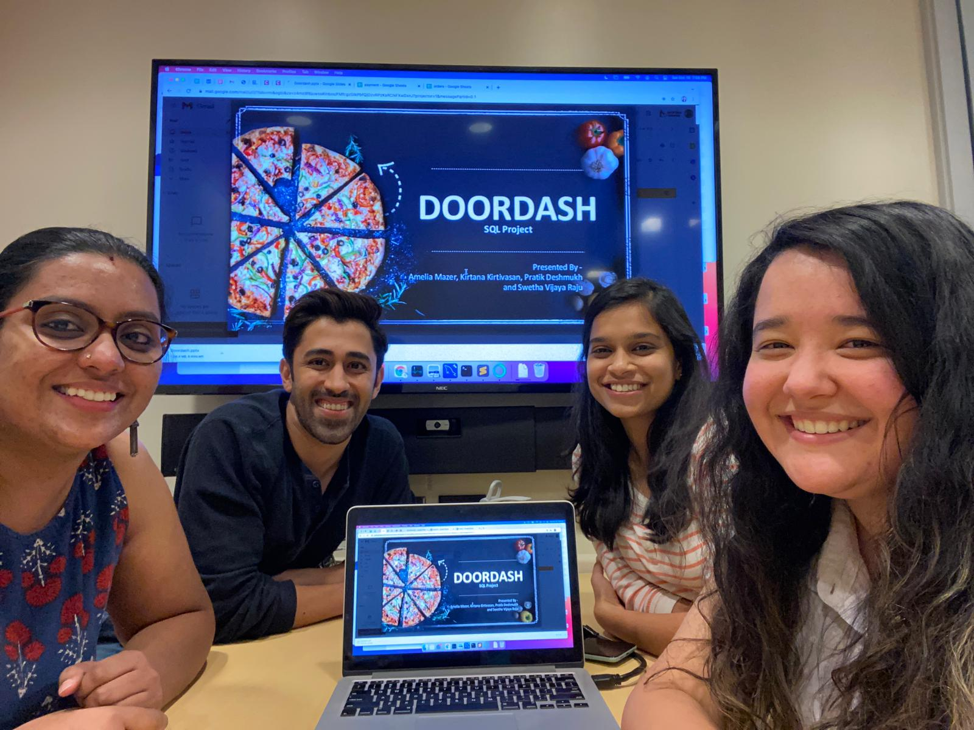
THANK YOU

